Slide 1

Lecture 11. METHODS of SELECTION of the PERSONNEL

Slide 2
QUESTIONS:
1. Contactless methods of an estimation.
2. Testing at an estimation of candidates at hiring.
3. Contact methods of an estimation of candidates.
4. Selection procedure.
5. Decision-making on hiring.

Slide 3
1. The resume analysis
2. Telephone interview
3. Interview (interview)
4. Testing
5. Check of responses and recommendations,
6. An expert estimation
7. Socially-psychological training
8. Decision-making.
9. The contract conclusion.

Slide 4
By sign «contactless the candidate and the employer during selection» estimation methods classify degree in three groups: contactless, semicontact and contact.
Contactless methods of an estimation.
By sign «kontaktirovani the candidate and the employer during selection» estimation methods classify degree in three groups: contactless, semicontact and contact.
Contactless methods of an estimation of candidates.
The employer carries out preliminary acquaintance to candidates more often in absentia - studying sent by them declaratory documents.
The analysis of each of them allows to make primary impression about the applicant and to define necessity of contact dialogue, and also to save time to workers of service of management of the personnel, especially at a considerable quantity of vacancies and wishing to receive a workplace.

Slide 5

The package includes the following declarative documents: declarative letter, curriculum vitae, resume, educational and employment certificates, forms, letters, photographs, and medical conclusion of handwriting analysis.

Slide 6
The first document is a written application for admission.
Despite the different points of view regarding the information weighty statement experts say that it is often "more than a biography, there is the candidate's identity."
Here is an opportunity to communicate their particular desire for the work, to justify the change of the workplace to explain the desire to get a job is in this company, to state interests in relation to the expected positions.

Slide 7
For the analysis of each enterprise application forms and uses a specific system of evaluation criteria.
The ideal application in the form, construction and method of wording is a serious business letters and at the same time -
compressed "project sales of own business" hired.
In most cases, the analysis of the statements in the company draws attention to the four main points: 1) the appearance, or design; 2) content; 3) accuracy; 4) style.
Appearance statements should give the company a first impression of the person hired and the seriousness of his intentions.

Slide 8

The content of the statement must inform the person to hire position with specificity positions and be calculated on the expectations of the enterprise information mentioned in the ad or in replacement of a vacant post.
The most widely used in the practice of analysis Rüdiger grading scale, which is based on the style of such components as figures of speech, the construction proposals combination of proposals and vocabulary.

Slide 9
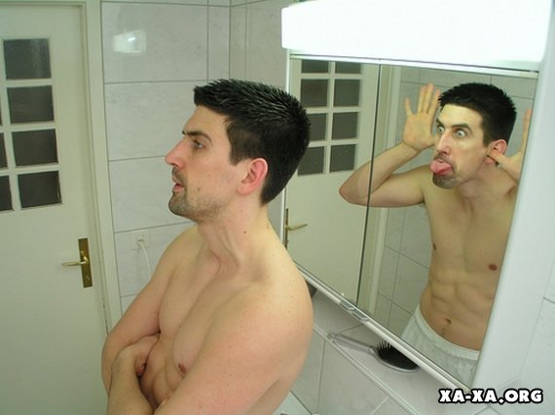
Autobiography is a document, the most suitable for a fairly rapid review of professional and personal development and formation of the candidate.
One of the most discussed is the problem of the appearance of the biography.
One contender today in most cases requires tabular form autobiography, due to clarity and the ability to best handle and evaluate data.
The European version of tabular forms - a traditional chronological presentation of events, ranging from birth to the last workplace.
The American version - events, starting with today's status, further down the slope in the past.
"Reverse" order biography was laid in the foundation of one of the relatively new application documents - resume

Slide 10

На основании результатов анализа должна быть выстроена личностно-социальная философия становления кандидата, которая включает:
– общую тенденцию и качественные изменения в совершенствовании личности;
– социокультурный уровень и фон развития;
– существенную тематику судьбы, т. е. характерологические и судьбоносно-психологические элементы.
«Пробелы» в биографии (чаще всего вуалирующие длительную болезнь кандидата, безработицу или занятость в «невыигрышных» сферах, привлечение к уголовной ответственности) вместе с неоднородным развитием и становлением кандидата выдают его недисциплинированность, непоследовательность или авантюризм.
Важным элементом анализа является также возраст кандидата, допускающий различные толкования и оценку при смене профессионального направления, должности и работодателя.

Slide 11

CV is the Russian equivalent of Curriculum Vitae (CV) for the usual western employers and candidates for hiring the standard presentation of professional and personal data.
As a "hybrid" of the declarative letters and biographies, summary aims to the fullest and at the same time compressed image of the employer to submit the applicant for the vacant post

Slide 12
The role of the resume of the candidate may be either positive.
Positivity, firstly, that the applicant for the position can form his own portrait, resume, characterizing it as an excellent candidate for the position, which he expects.
Secondly, drawn up in accordance with the relevant principles and not similar to any of the submitted, resumes may be interested in a potential employer, which will increase the chances of candidates being hired.
Third, well-written resume, even in the face of fierce competition drew the attention of an expert, but it provides to its author a chance to be invited for an interview.

Slide 13

There are three main types of CV: chronological, functional and functional and chronological (mixed):

Slide 14

Questioning, as an important tool in the selection of personnel for jobs and performing a single function - to provide answers to these questions now,
As a basis for the development of the company profiles can be used classic version of it, grouping questions in 10 main sections:
1. Autobiographical information
2. Housing
3. Vocational
4. Spouse (s), children, parents
5. disabilities
6. Military Service
7. The previous practical activity
8. Other interests and abilities
9. Miscellaneous
10. Future employment

Slide 15

When hiring a number of enterprises candidate must together with the other application documents to present a handwritten biography or during the interview down on paper thoughts on any topic for future conduct handwriting analysis

Slide 16
Testing in the evaluation of candidates when hiring
Testing of candidates referred to as psychological "semi-contact" method of selection: meeting HR staff and the applicant is happening, but is a mere formality, and the result of selection is determined not by the facts and impressions obtained during the live communication, and the contents of the completed forms.
An advantage of the method - that, firstly, the ability to identify the individual, or any other reaction, and then measuring them in "standard conditions" and "objective", and secondly, the ability to compare the quality of the identified subjects with other characteristics, ie. E. on a scientific basis and is valid for the company and the applicant to carry out the selection of fitness.

Slide 17

classification interviews
biographic
Case
projective
Behavioural
Ctress

Slide 18

Thank you for your attention

